Slide 1
NYSE Analysis With MySQL
Ethan Graham, Scott Gozdzialski, Huynh Vu
Graduate Students Master of Data Science
Southern Methodist University
Dallas, Texas
Github link
https://github.com/DSSMU/MSDS7330_Project

Slide 2
NYSE Securities Analysis With MySQL
Initial plan: https://cran.rstudio.com/web/packages/stocks/index.html
Utilities, but no actual data
Better Plan: https://www.kaggle.com/benjibb/lstm-stock-prediction-20170507/data
NYSE DATA FROM 2010-2016

Slide 3
Data
The data consists New York Stock Exchange data from 2010 to 2016. It is made up of four files.
Prices.csv - Raw daily stock prices 50.4MB
Prices-split-adjusted.csv – adjustment for and stock splits 51.4MB
Securities.csv – descriptions of the companies and different sectors 60KB
Fundamentals.csv – SEC 10K filings for each company 1.3MB
Total Data size is 103.6MB
This data was used in a SQL database on two Mac machines running the SQL server on Bluemix and one Windows 10 Machine running SQLite3.

Slide 4
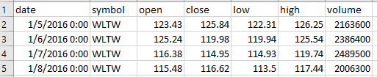
Data
Prices.csv - Raw daily stock prices 50.4MB
Prices-split-adjusted.csv – adjustment for and stock splits 51.4MB
The heading for Prices.csv and Prices-Split.csv are Date, Symbol, Open, Close, Low, High, and Volume
Example below.

Slide 5
Data
Securities.csv – descriptions of the companies and different sectors 60KB
The heading for Securities.csv are Ticker Symbol, Security, SEC filings, GICS Sector, GICS Sub Industry, Address of Headquarter, Date first added, CIK
Fundamentals.csv – SEC 10K filings for each company
The headings for fundamentals is ID, Ticker Symbol, Period Ending, Accounts Payable, Add’l income/expense items, After tax ROE, Capital Expenditures, Capital surplus, Cash Ratio, cash and Cash equivalents Changes in Inventories, Common Stocks, Cost of revenue, Current ratio, deferred Asset Charges, Deferred Liability Charges, Depreciation, earnings Befroe Interest and tax, Earning Before tax….and 61 others covering all Net, Gross, and Tax Expendature, Revenue, or Liability.
These files take up to much screen to display an example below.

Slide 6
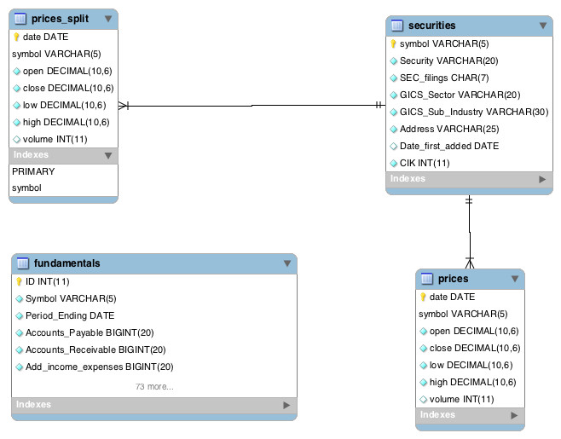
MYSQL DATABASE
The Data was put into an SQL Database with the Ticker Symbol as the unifying key.
Relation shown below

Slide 7
MYSQL DATABASE DDL example
CREATE TABLE securities
(
symbol VARCHAR(5) PRIMARY KEY,
Security VARCHAR(20) NOT NULL,
SEC_filings CHAR(7) NOT NULL,
GICS_Sector VARCHAR(20) NOT NULL,
GICS_Sub_Industry VARCHAR(30) NOT NULL,
Address VARCHAR(25) NOT NULL,
Date_first_added DATE,
CIK INT NOT NULL
);
The entire DDL structure is located in the github link displayed on the first slide

Slide 8
MYSQL DATABASE DML example
use stocks;
LOAD DATA LOCAL INFILE '/Users/Ethan/Desktop/nyse/securities.csv' INTO TABLE securities
FIELDS TERMINATED BY ',' ENCLOSED BY '"' IGNORE 1 LINES;
LOAD DATA LOCAL INFILE '/Users/Ethan/Desktop/nyse/prices.csv' INTO TABLE prices
FIELDS TERMINATED BY ',' IGNORE 1 LINES;
CREATE OR REPLACE VIEW assets AS
SELECT avg(Total_Assets) as Assets, symbol FROM
fundamentals Group By symbol ORDER BY Assets DESC LIMIT 10;
The entire DML structure is located in the github link displayed on the first slide

Slide 9
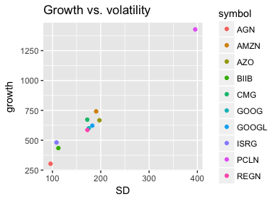
Insight 1
Is there a relationship between stock growth and volatility?
We use prices-split-adjusted to account for changes of Stock value based on splits. We use the standard deviation of the stock as a measure of volatility.
SELECT * FROM
(
SELECT symbol, max(high)-min(low) AS growth
FROM prices_split
GROUP BY symbol
)
AS subTable ORDER BY growth ASC LIMIT 1;

Slide 10
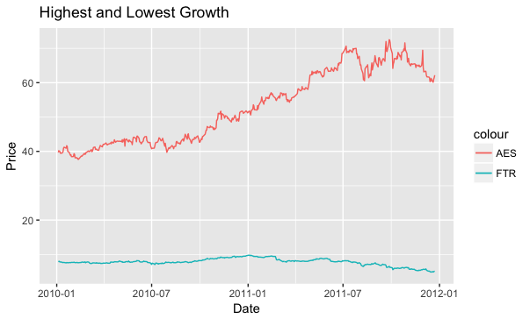
Insight 2
Building on insight 1, what is the visual difference between the highest growth stock and the lowest growth stock. Again, we use prices-split-adjusted to account for changes of Stock value based on splits.
SELECT * FROM
(
SELECT symbol, max(high)-min(low) AS growth
FROM prices_split
GROUP BY symbol
)
AS subTable ORDER BY growth ASC LIMIT 1;

Slide 11
Insight 3
Insight 3 we look into the different GICS sub industries to see how great of a difference there is in each sub industry. There are 124 different sub industries, so we are highlighting the top 5 and bottom 5.
SELECT GICS_Sub_Industry , AVG(newhigh)-AVG(newlow) AS avg_growth
FROM(
SELECT AVG(high) AS newhigh, AVG(low) AS newlow, GICS_Sub_Industry
FROM (
SELECT *
FROM securities natural join prices_split) AS combined
GROUP BY symbol
) AS temp
GROUP BY GICS_Sub_Industry
ORDER BY avg_growth DESC;

Slide 12
TOP 5
Internet & Direct Marketing Retail | 7.53716222651872
Life Sciences Tools & Services | 3.93256237883045
Casinos & Gaming | 3.72577750510828
Industrial Materials | 3.69075463507389
Biotechnology | 3.48485485142692
BOTTOM 5
Integrated Telecommunications Services | 0.451242797284351
Publishing | 0.443185394110685
Independent Power Producers & Energy Traders | 0.425368906923989
Technology Hardware Software and Supplies | 0.424676514188445
Thrifts & Mortgage Finance | 0.244812714528964

Slide 13
Insight 4
This one is a little more confusing, using the same files as above we focus on Amazon. We look into growth per year verse capital expenditures and earnings before tax.
SELECT MAX(high) - min(low) AS growth, capital_expenditures, YEAR(date), Earnings_Before_Tax
FROM prices_split JOIN fundamentals ON
prices_split.symbol = fundamentals.symbol AND For_Year = YEAR(date)
WHERE prices_split.symbol = "AMZN"
GROUP BY symbol, YEAR(date) LIMIT 10;
growth | capital_expenditures | YEAR(date) | Earnings_Before_Tax
159.880005 | -3444M | 2013 | 506M
124.059998 | -4893M | 2014 | -111M
411.190002 | -4589M | 2015 | 1568M
Capital expenditures and Earning before tax are displayed in millions or dollars to save space

Slide 14
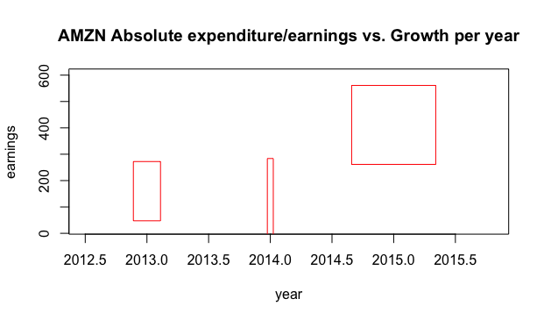
Insight 4

Slide 15








Insight 5
NEEDS STUFF. Here is a farm to grow our ideas.

Slide 16
Conclusion
We looked into different stock data. Found at https://www.kaggle.com/benjibb/lstm-stock-prediction-20170507/data
Placed into a SQL relational DB where we looked at the data.
All information can be found at https://github.com/DSSMU/MSDS7330_Project

Slide 17
Questions?

